Slide 1
On the wings of an Eagle.

Slide 2
Supporting Malawian Missionaries.

Slide 3
The work of Hope and love.

Slide 4
Malawi has become the poorest country in the world.

Slide 5
Pastor Julius holding baby born in the floods. The father and other kids died.

Slide 6
The Shire River- giving their lives to Christ sometimes 30 people in a week.

Slide 7
Julius giving plastic sheets to sleep on

Slide 8
About 45,000 people were displaced

Slide 9
Only Mud left.

Slide 10
June 2015 Water gone but not the suffering.

Slide 11
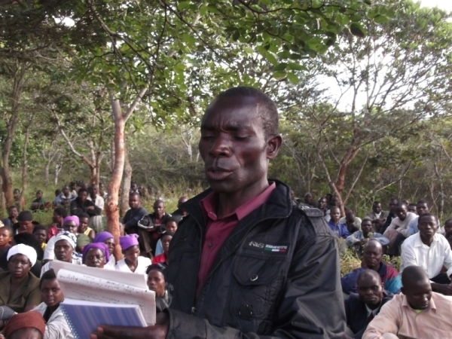
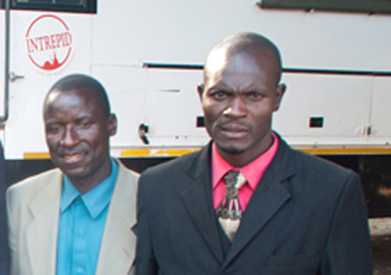
Steven
Preaching, showing the love of Jesus, helping the widows,
Sunday schools, visiting prisons, and hospitals. Adopting kids -
Steven
Kennedy
Biston

Slide 12
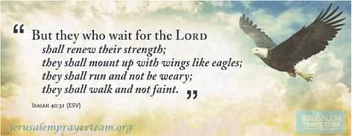
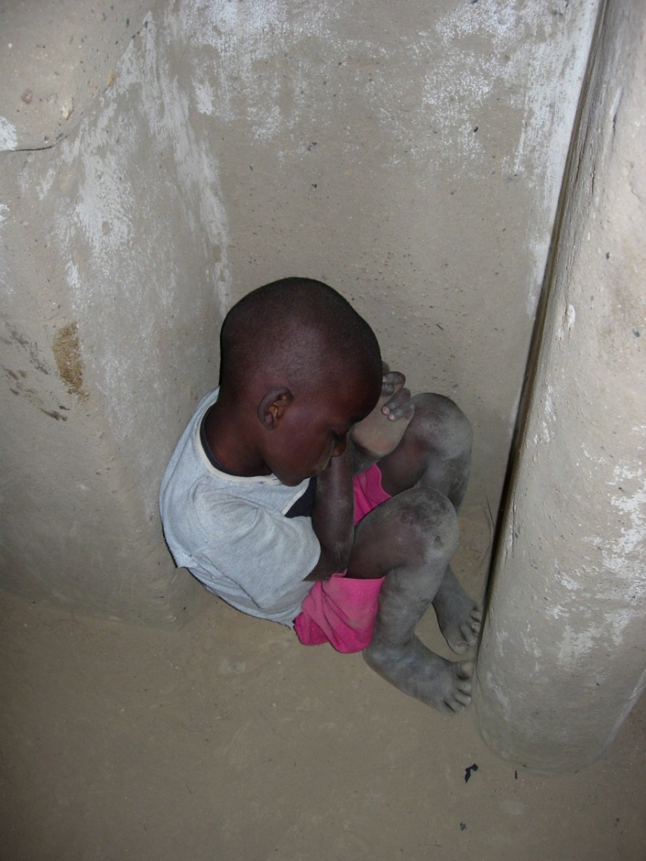
P PRAY

Slide 13
Giving

